Slide 1

UNEMPLOYMENT AND CORRELATED INDICATORS Comparison among BRIC countries
Programming for Data Analytics
Rachel Fanti Coelho Lima

Slide 2
Goal and motivation
Analyze the unemployment and the socio-economic indicators most related to it.
Make comparisons for different countries, understanding what are the differences in behaviour of this variable and which are the indicators more relevant in each country.

Slide 3
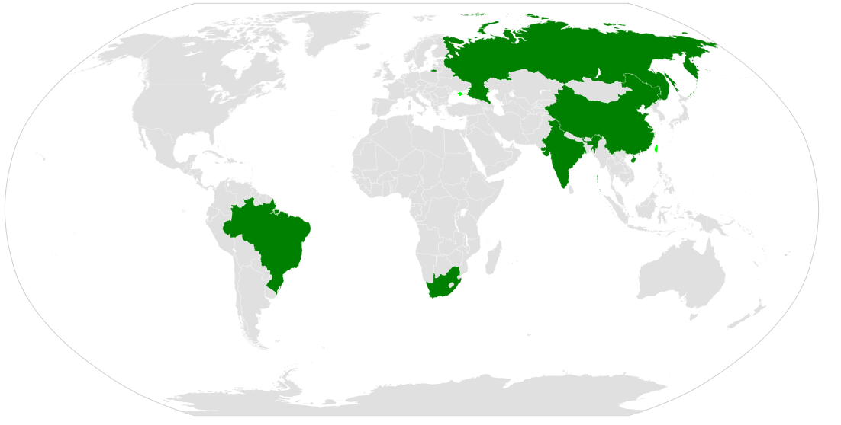
Dataset
BRICS World Bank Indicators (https://www.kaggle.com/docstein/brics-world-bank-indicators)
BRICS is the acronym coined to associate five major emerging national economies: Brazil, Russia, India, China and South Africa.
Indicators
Economy
Education and Environment
Health and Poverty
PublicSector_Indicators
World Development Indicators
(https://databank.worldbank.org)

Slide 4
Indicators Selected
Health and Poverty
Economy
PublicSector_Indicators
Education and Environment
Net lending (+) / net borrowing (-) (% of GDP)
Government expenditure on education, total (% of GDP)
GDP (current US$)
GDP per capita (current US$)
Poverty headcount ratio at national poverty lines (% of population)
Manufacturing, value added (% GDP)
Services, value added (% GDP)
Industry (including construction), value added (% GDP)
Agriculture, forestry, and fishing, value added (% GDP)
General government final consumption expenditure (%GDP)
Labor force, total
Wage and salaried workers, total (% of total employment)
Self-employed, total (% of total employment)
Unemployment, total (% of total labor force) (Total, male and female)
Unemployment participation rate for ages (15-24),
Children in employment, total (% of children ages 7-14)
Rural population (% of total population)
Population living in slums (% of urban population)
Urban population (% of total population)
Children out of school (% of primary school age) (Total, male and female)
Adolescents out of school (% of lower secondary school age) (Total, male and female)
Vulnerable employment, total (% of total employment)
Unemployment (% of total labor force with advanced, intermediate or basic education)
Imports of goods and services (% of GDP)
Exports of goods and services (% of GDP)
Foreign direct investment, net inflows (BoP, current US$)
Population (total, male and female)
GDP per capita growth (annual %)
Employers, total (% of total employment)
Trade (% of GDP)
Informal employment (% of total non-agricultural employment)
Labor force participation rate for ages (15-24, 24-64, 64+)
Poverty headcount ratio at $1.90 a day (2011 PPP) (% of population)
Individuals using the Internet (% of population)
Legend:
Complementar data
Indicators to be considered in the regression

Slide 5
Main Steps
Preparation and exploration of the dataset, understanding the concepts and validating the data.
Carrying out the main analyses, including summary overview, correlations between the indicators, best features and regression.
Summary of main results, model significance and recommendations.

Slide 6




Data Analyses
Summary overview Correlations Best features Regression

Slide 7



Data Analyses
Summary overview Correlations Best features Regression

Slide 8
Summary overview Unemployment and the socio-economic indicators most related to it.
Characterization of each country :
Economy
GDP
GDP by the sectors of the economy
Population
Urban x rural
Employment
Employment by sector
Self employed x Wage and salaried workes
Vulnerable employment
Unemployment
Unemployment by level of education
Unemployment by gender
Unemployment by age
Labour force participation rate
Notes:
Labour statistics

Slide 9
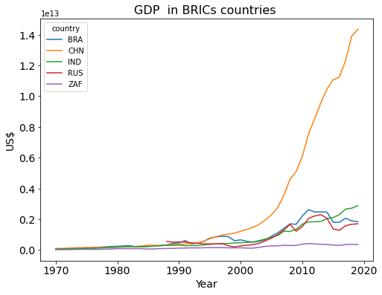
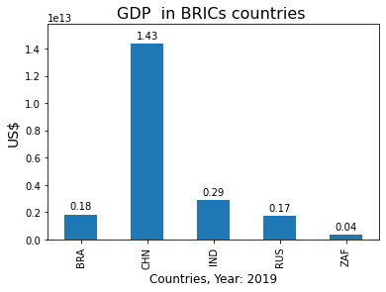
Summary overview - Economy GDP
* 10 trilion
* 10 trilion
In China, since 1990, there has been a significant increase in GDP, at a much higher level compared to other BRICS countries.
In India the growth of GDP is almost continuous.
Brazil and Russia have a very similar curve.
The growth of GDP in South Africa is slow.

Slide 10
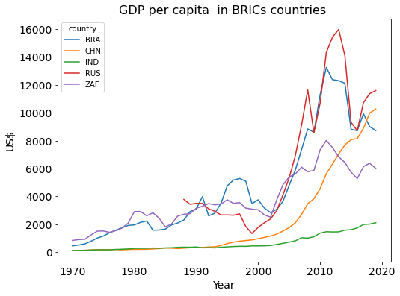
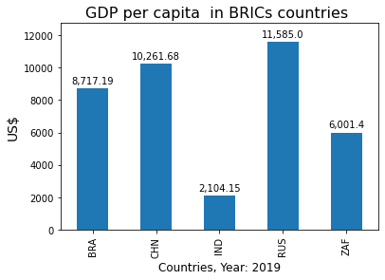
Summary overview - Economy GDP per capita
Despite the rapid growth of GDP in China, Russia has a higher GDP per capita.
Brazil and Russia had a relatively similar curve behaviour after mid-2000. However, the values in Brazil were lower than in Russia in this period.
After 2018, China becomes the second country with the highest GDP per capita among the BRICS countries.
South Africa has a GDP per capita higher than India.
The latter is the country of the BRICS with the lowest GDP per capita.

Slide 11
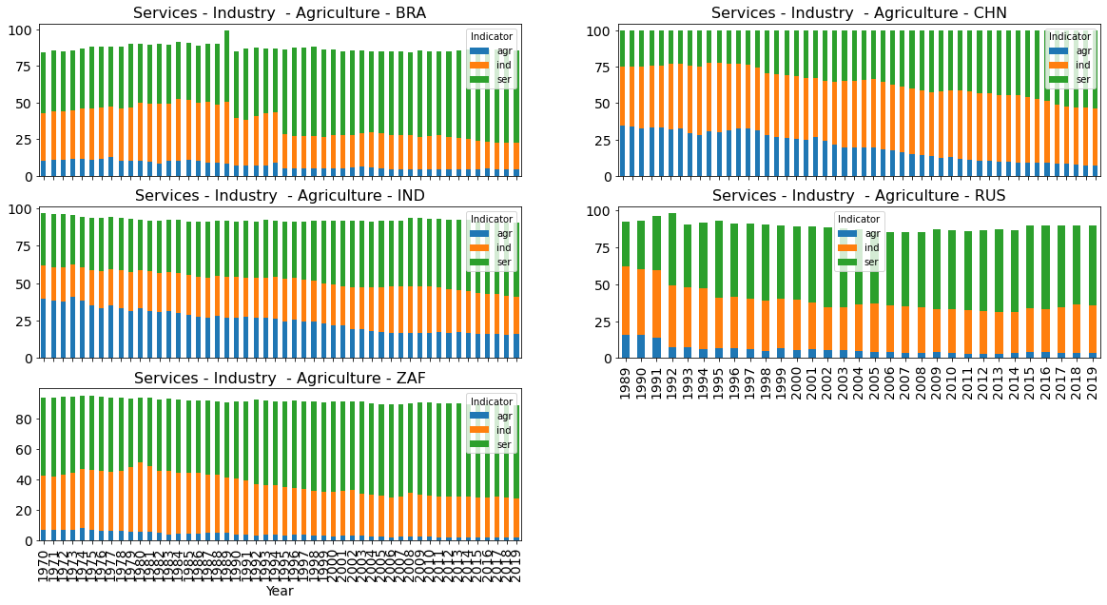
Summary overview - Economy GDP by sector of the economy
In all countries, the percentage of agriculture in GDP has decreased over the years and the percentage of services has increased.
India is the country with the largest share of agriculture in GDP compared to the BRICS countries (16%), followed by China (7%).
In industry, China is the country with the largest share in GDP compared to the BRICS countries (39%), followed by Russia (32%).
Notes:
Supplementary notes
The source does not provide any information regarding percentage points not adding up to or exceeding 100 percent.

Slide 12
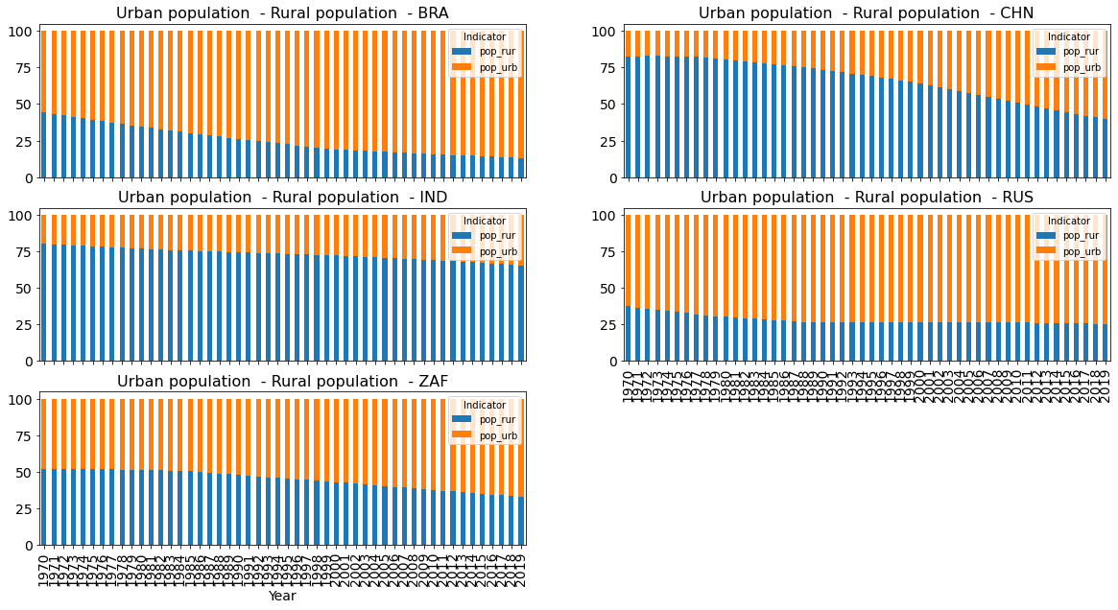
Summary overview - Population Urban x Rural population
In all countries, the percentage of rural population has decreased over the years.
India is the only country in the BRICS that has more participation of rural than urban population (65%).
The second and third countries with more rural participation are China (39%) and South Africa (33%).

Slide 13
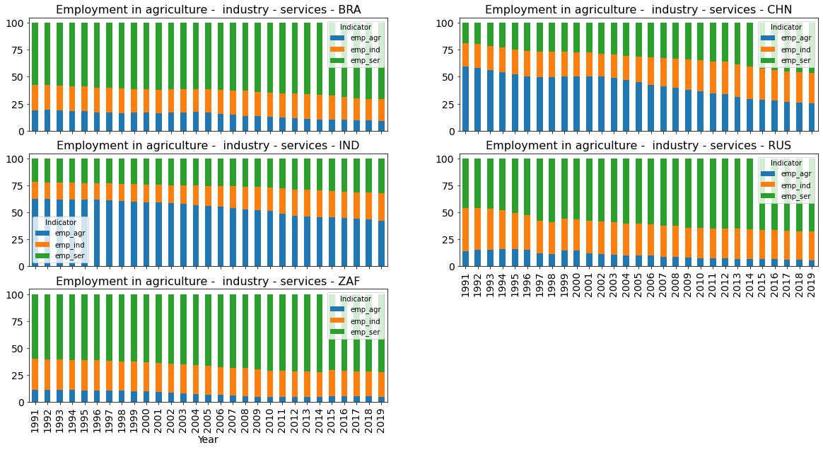
Summary overview - Employment Employment by sector
Although agriculture contributes only 16% in India’s GDP, it contributes 42% in India's employment.
The same pattern happens with China. Although agriculture contributes only 7% in China’s GDP, it contributes 25% in China's employment.

Slide 14
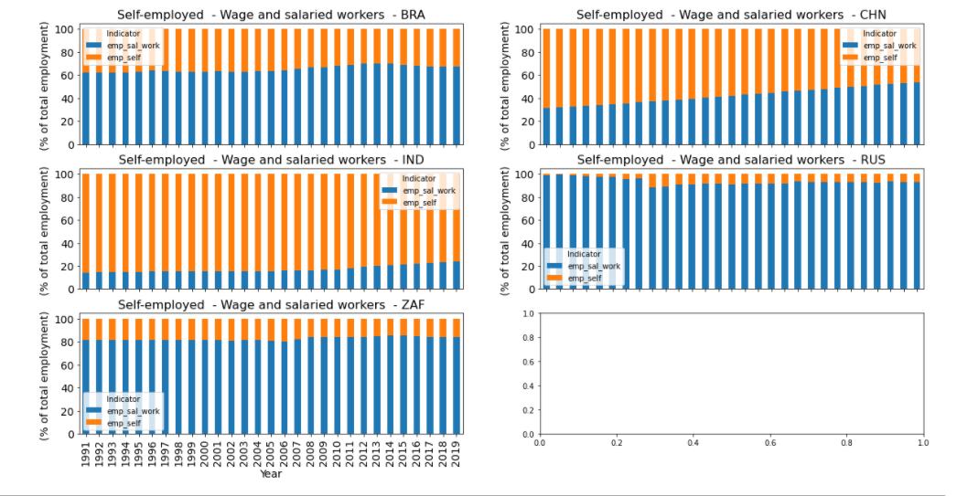
Summary overview - Employment Self employed x Wage and salaried workes
In India, approximately 76% of total employment are self-employed; in China, 47%. On the other hand, the percentage of wage and salaried workers in these countries are continually increasing, mainly in China.
In South Africa and Russia the percentage of salaried workers is high, approximately or above 80%.
Notes:
While in India is the opposite of Russia and ZAF

Slide 15
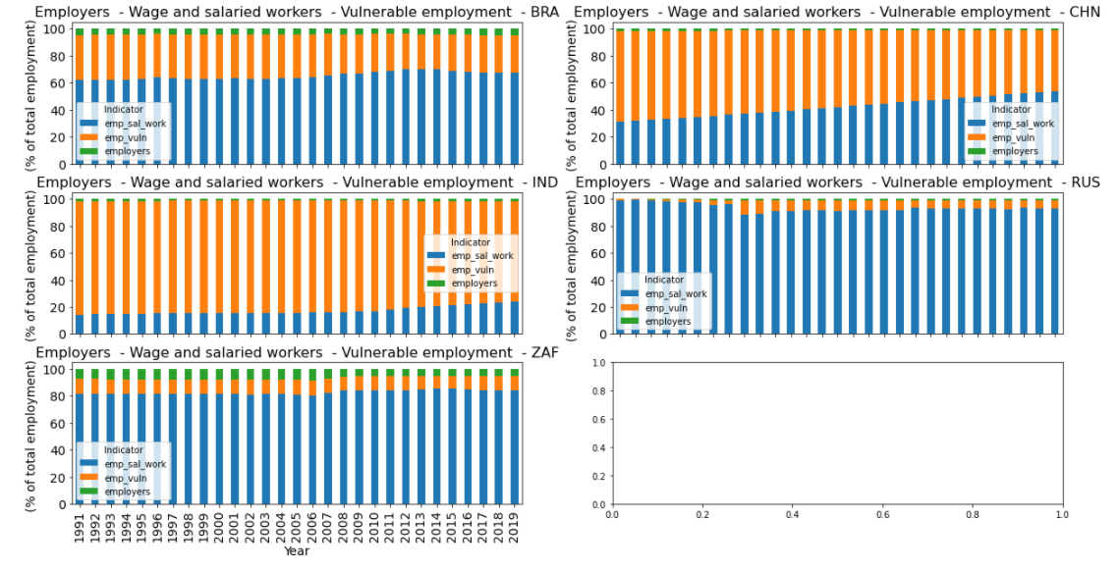
Summary overview - Employment Employers x Wage and salaried workes x Vulnerable employment
India and China are the countries with more vulnerable work, 74% and 45%, respectively.

Slide 16
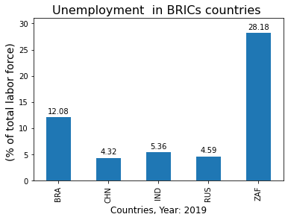
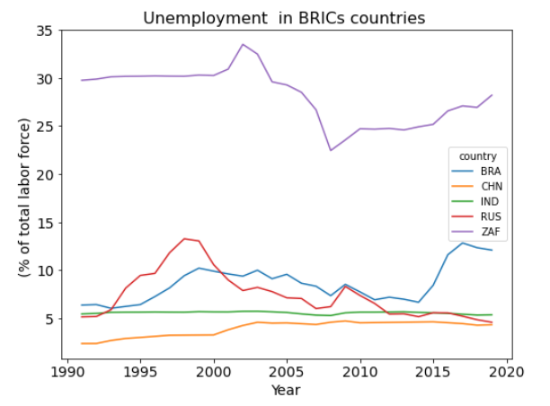
Summary overview - Unemployment Unemployment rate
Unemployment in Brazil is at its peak
Unemployment in India is almost stable.
In China, it has also been relatively stable for the past 15 years.
Supplementary note:
Regarding the international comparability of unemployment rates, there are some differences in their measurements, which can affect the comparability of results across countries.
Almost 28% of labour force
is unemployed in South Africa
The unemployment in Russia is in a downward trend since 1998
Notes:
UR (%) = Persons unemployed x 100 Labour force
Labour force = Persons employed + persons unemployed

Slide 17
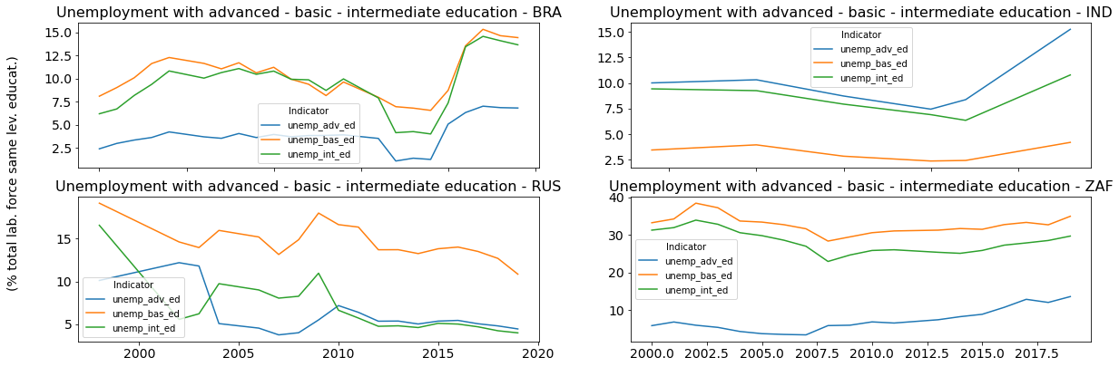
Summary overview - Unemployment Unemployment by level of education
Unemployment with:
advanced education (% of labour force unemployed with advanced education/ % of total labour force with advanced education)
intermediate education (% of labour force unemployed with intermediate education/ % of total labour force with intermediate education)
basic education (% of labour force unemployed with basic education/ % of total labour force with basic education)
* In India the unemployment rate for people with advanced education is higher than for those with intermediate and basic education.
* There is no data for China.

Slide 18
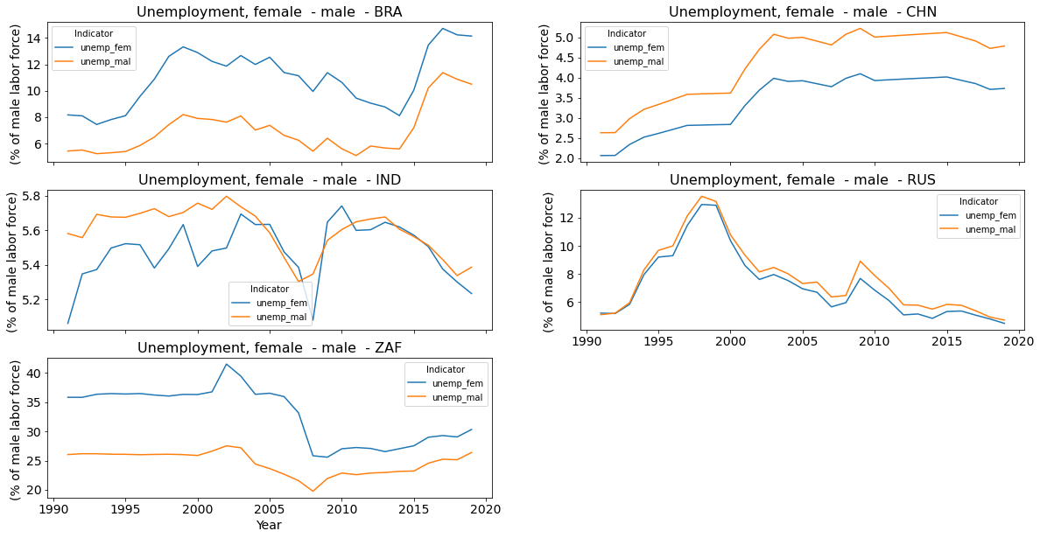
Summary overview - Unemployment Unemployment by gender
male unemployment (% of male labor force)
female unemployment (% of female labor force)
There is more female unemployment than male unemployment in Brazil and in South Africa.
In China, there is more male unemployment.
The unemployment between genders in Russia occurs in a balanced way.
In India is relatively balanced for almost 10 years.
It is important to evaluate how is the proportion of the female labour force in relation to the total population in other countries (next slide).

Slide 19
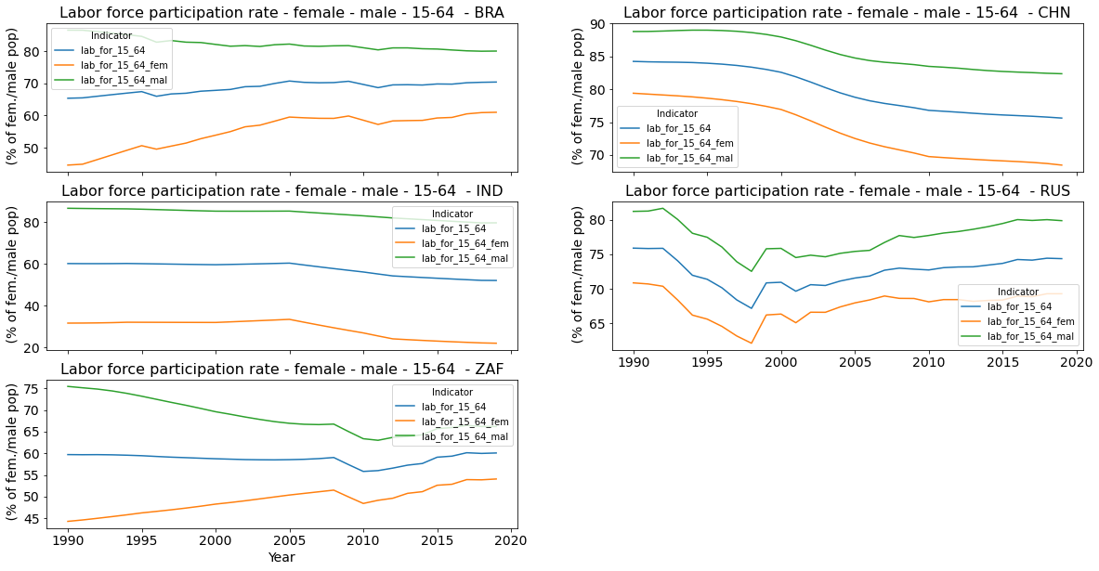
Summary overview – Labour force Labour force participation rate by gender
lab_for_15_64_fem: (% of female population ages 15-64)
lab_for_15_64_mal: (% of male population ages 15-64)
lab_for_15_64: (% of population ages 15-64)
In India the percentage of female labour force is relative low compared to other countries.
The percentage of female labour force in China and Russia is higher than Brazil and South Africa.

Slide 20
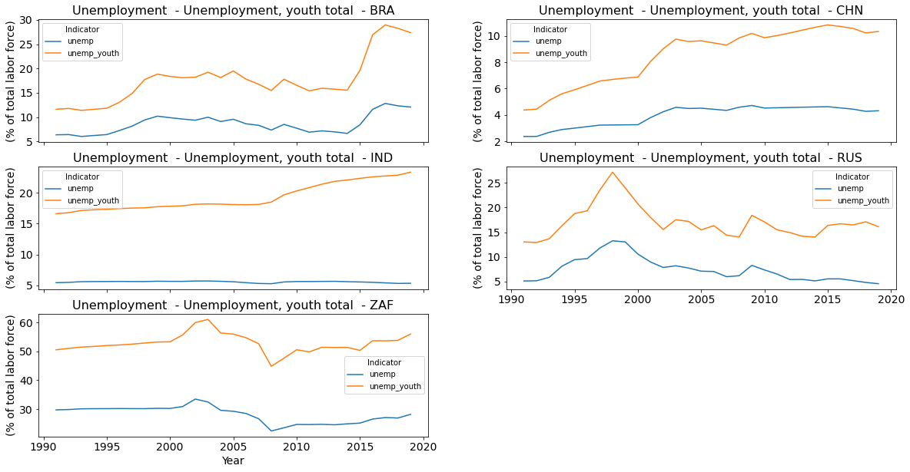
Summary overview - Unemployment Unemployment by age
The youth unemployment is above the unemployment rate in all BRICS countries.

Slide 21
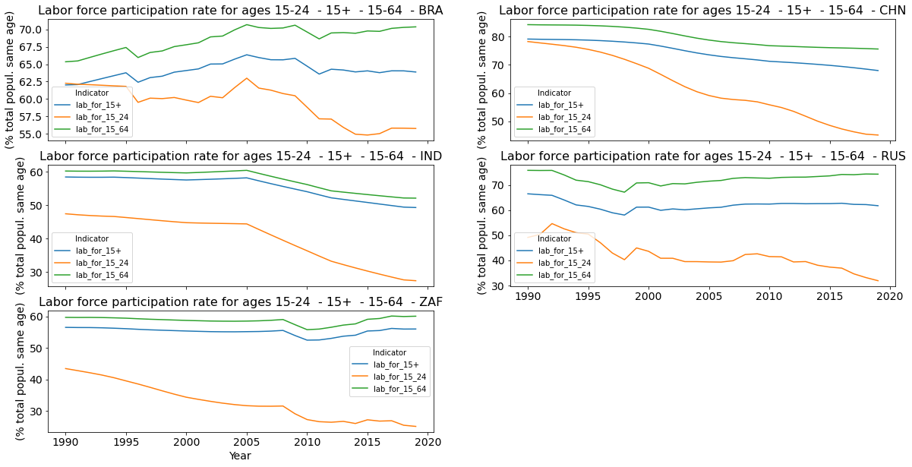
Summary overview - Labour force Labour force participation rate by age
LFPR(%) = Labour force/Working-age population x 100
Labour force = Persons employed + persons unemployed
Comments:
* In all BRICS countries the percentage of total labor force ages 15-24 has significantly decreased in the last 30 years.

Slide 22

Data Analyses
Summary overview Correlations Best features Regression

Slide 23
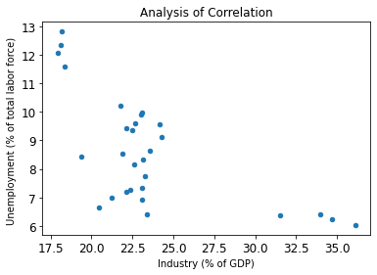
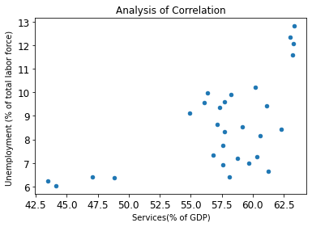
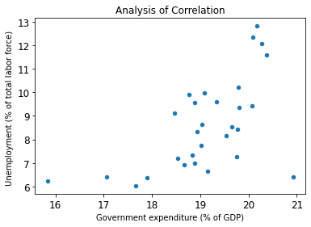
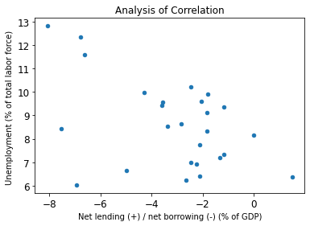
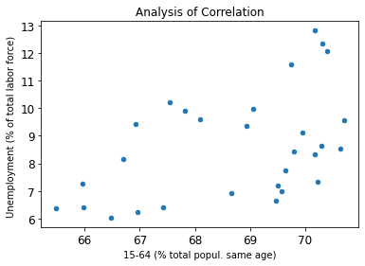
Interesting correlations between indicators - BRAZIL

Slide 24
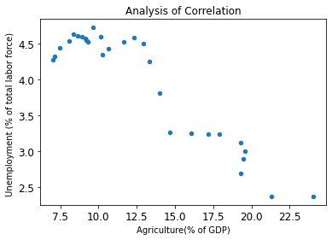
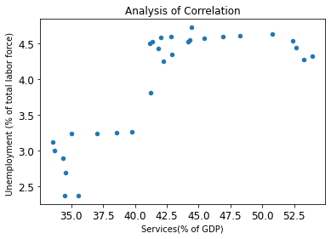
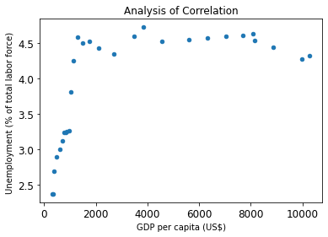
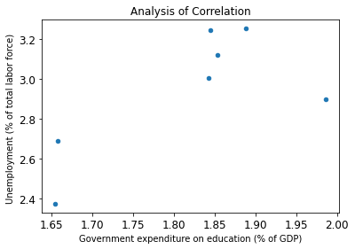
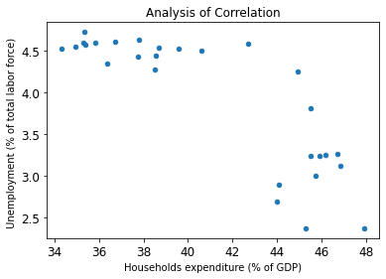
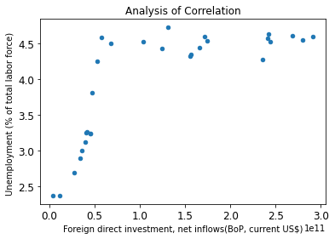
Interesting correlations between indicators - CHINA

Slide 25
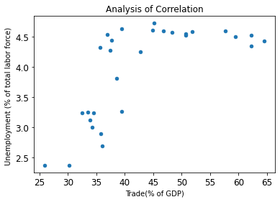
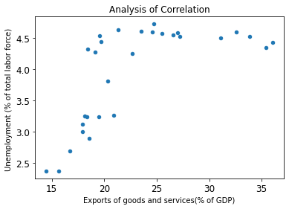
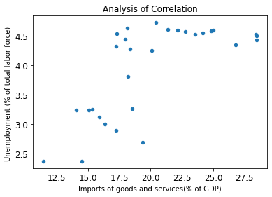
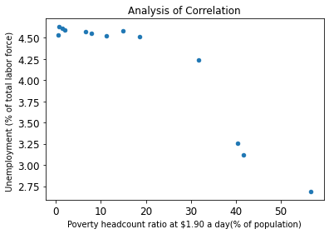
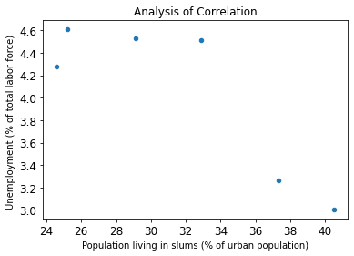
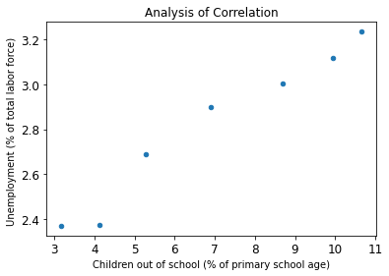
Interesting correlations between indicators - CHINA

Slide 26
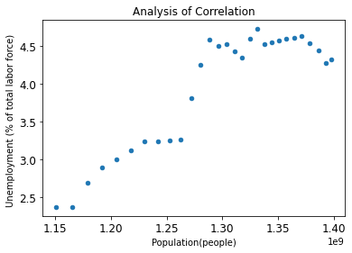
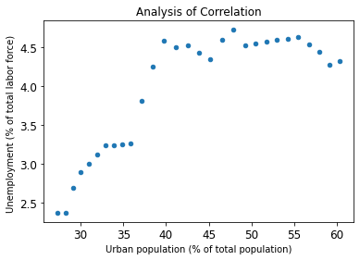
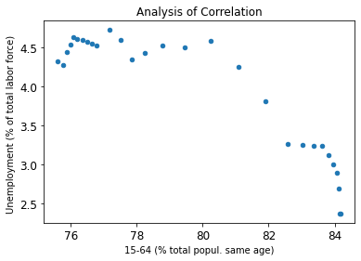
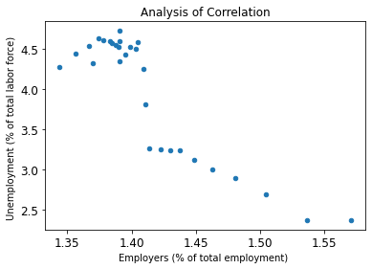
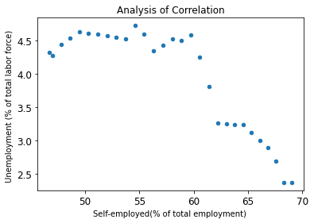
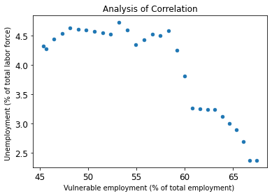
Interesting correlations between indicators - CHINA

Slide 27
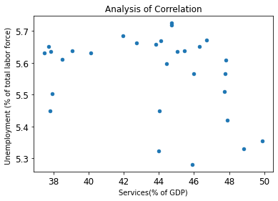
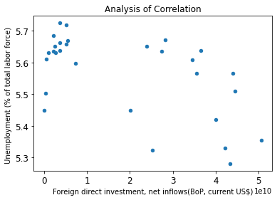
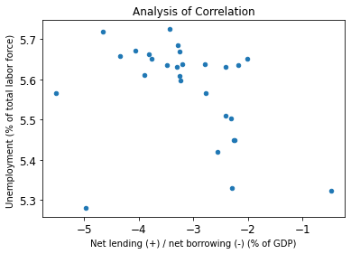
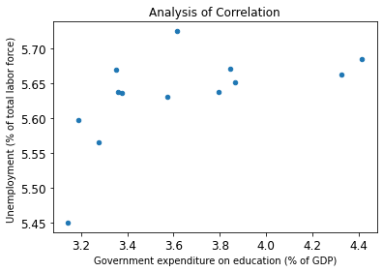
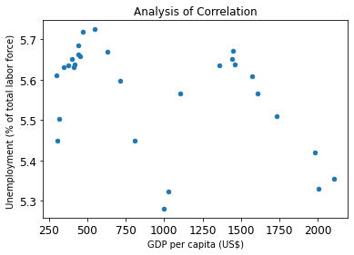
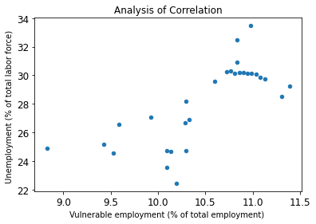
Interesting correlations between indicators - INDIA

Slide 28
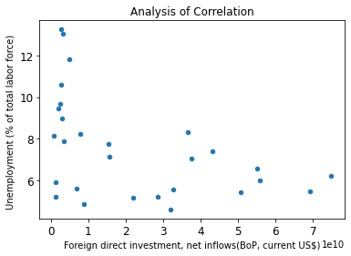
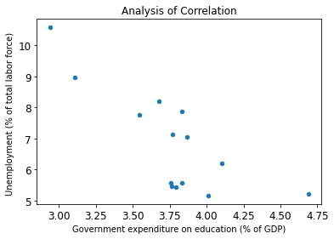
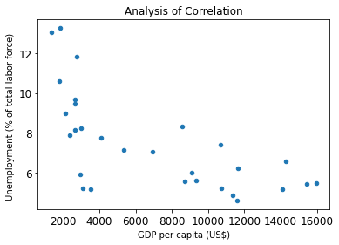
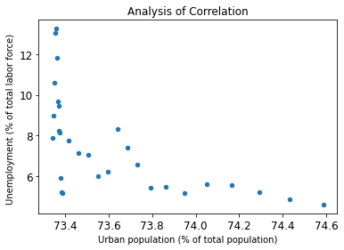


Interesting correlations between indicators - RUSSIA
Labour force
Labour force

Slide 29






Interesting correlations between indicators – South Africa

Slide 30




Interesting correlations between indicators – South Africa

Slide 31
Data Analyses
Summary overview Correlations Best features Regression

Slide 32
Choice of indicators for best features and regression
Y-axis variable: Unemployment
X-Axis variables to be considered:
Disregarded indicators by gender
e.g female population, male population, population
disregarded redundant indicators
GDP, GDP per capita,
GDP growth, GDP per capita growth
Urban population, rural population
Labour force (persons employed + persons unemployed)
Waged and salaried workers, self employed
Employment in agriculture, industry and services (keeping agriculture, industry and services (% of GDP))
Disregarded more detailed unemployment indicators
Unemployment, youth total
Unemployment with basic, intermediate and advanced education

Slide 33

X-Axis variables: Indicators considered
X
Disregarded indicators:
Few data (>= 25% of not null)
X
X
X

Slide 34
3 best features of each country
When the 2nd or 3rd indicators were
redundant with the previous ones, I disregarded them and ran it again.

Slide 35
3 best features of each country
NEXT STEP
Regression analyses for the first and second best features
When the 2nd or 3rd indicators were
redundant with the previous ones, I disregarded them and ran it again.

Slide 36
Data Analyses
Summary overview Correlations Best features Regression

Slide 37




Regression - Brazil
Industry (including construction), value added (% of GDP)
Services, value added (% of GDP)

Slide 38



Regression - China
Agriculture, forestry, and fishing, value added (% of GDP)
Population, total

Slide 39



Regression - India
Foreign direct investment, net inflows (BoP, current US$)
GDP per capita (current US$)
!

Slide 40



Regression - Russia
Labor force participation rate, total (% of total population ages 15-64)
GDP per capita (current US$)

Slide 41



Regression – South Africa
GDP per capita (current US$)
Employers, total (% of total employment)

Slide 42
K sensitivity analyses

Slide 43




K sensitivity analysis – BRA - SERVIÇOS (K = 5, 10, 20, 29)
1
Country: BRA
Best score: -3.9833810125632554 Cross validation 5 Degree: 1
Best score: -2.1141379917315115 Cross validation 10 Degree: 4
Best score: -1.6108313166377428 Cross validation 20 Degree: 18
Best score: -1.3503898258407092 Cross validation 29 (leave one out) Degree: 5
2
3
4

Slide 44

K sensitivity analysis – RUS – GDP PER CAPITA (K = 5, 10, 15, 20)
Country: RUS
1. Best score: -6.639959177625654 Cross validation 5 Degree:
2. Best score: -3.7924479029625546 Cross validation 10 Degree: 5
3. Best score: -3.008105927607781 Cross validation 15 Degree: 5
4. Best score: -2.5174631553244335 Cross validation 20 Degree: 5
5. Best score: -2.334750796314984 Cross validation 29 Degree:
1
2
3
4
5

Slide 45
Selection of other parameters

Slide 46




Regression – India Regression - Russia
Government Expenditure on Education (% of GDP)
Government Expenditure on Education (% of GDP)

Slide 47
Conclusions

Slide 48

Best features and correlation results
↑ + correlation
↓ - correlation
BF – Best features
CR – Correlation

Slide 49
Main conclusions 1/3
GDP per capita is the most common feature correlated to unemployment among the countries.
Other relevant common features are vulnerable unemployment, labour force participation rate, government expenditure and foreign direct investment and net inflows.
Generally, when the unemployment increases, GDP per capita decreases. However, in China, unemployment and GDP per capita increase along the time. In Brazil, these 2 variables are not correlated.
While in Brazil unemployment is related to the decrease in the industry (as a % of GDP), in China, is related to the decrease in agriculture. In both countries, when the unemployment rate increases, the percentage of services in GDP increases, too.
In South Africa and Russia, the government expenditure (as a % of GDP) decreases when the unemployment rate growths whereas in Brazil and China it increases.
For India, Russia and South Africa, the foreign direct investment and net inflows reduce as the unemployment rises. In contrast, in China this indicator increases.
In China, when the unemployment increases, trading, the export and import of goods (as a % of GDP) increase too. Nevertheless, in South Africa the opposite is true: trading, export and import of goods decrease.
In South Africa, the higher the unemployment rate, the lower the percentage of waged and salaried worker and the higher the percentage of vulnerable employment. In India, the unemployment rate increases as the vulnerable employment increases, as well. However, in China, the percent of waged and salaried worker increase as the unemployment rate increases.
In China and Russia, the lower the labour force participating rate (labour force divided by the total working-age population), the higher the unemployment. In China labour force has been reducing along the years, whereas in Russia, since the beginning of the 2000s it has been increasing.
In Russia, the unemployment rate is lower when the percentage of the urban population is higher.
Notes:
The labour force participation rates is calculated as the labour force divided by the total working-age population.
As the household expenditure is represented as % of GDP is difficult to conclude something, it would be better if it was represented in dollars

Slide 50
Main conclusions 2/3
Result/accuracy
The model has a good result/accuracy for most analyses.
However, some regressions (mainly the second best features) did not represent the model in the best way:
In the second regression of Brazil, "Unemployment x Services", the model did not represent well the data with low values in axis x.
A similar problem occurred with the second graphic of Russia "Unemployment x GDP per capita". In this case, the model did not represent well the data with high values in axis x.
Both probably resulted in over-fitting.
The second graphic regression of India, "Unemployment x GDP per capita" was also less accurate.
Other graphics such as those in India and South Africa are more dispersed, consequently more complicated to be represented, but the results were relatively within expectations.
To improve these regressions may be necessary to test other methods. A study deeper is necessary, but maybe, for the solution of cases 1 and 2, can be interesting to use stratified sampling. Some classification problems can exhibit a large imbalance in the distribution of the target classes: for instance, there could be several times more high values x samples than low values samples. In such cases, it is recommended to use stratified sampling as implemented in StratifiedKFold and StratifiedShuffleSplit to ensure that relative class frequencies are approximately preserved in each train and validation fold.

Slide 51
Main conclusions 3/3
Strength:
The model analyse several variables to find the solution, including the number of cross-validation, degrees and parameters.
Limitations:
The model was chosen based only on the values of mean squared error. No statistical tests were performed or other parameters were calculated to actually validate whether the model is coherent.
The model is a regression for only one variable, the possibility of multiple regression has not been analysed.
It is necessary to study more the choice of K in K-fold cross-validation.
As a general rule, most authors, and empirical evidence, suggest that 5 or 10 fold cross validation should be preferred to high k-values or LOO (leave one out). In terms of accuracy, large K value and leave one out cross-validation would result in over-fitting, LOO often results in high variance as an estimator for the test error. Intuitively, since of the samples are used to build each model, models constructed from folds are virtually identical to each other and to the model built from the entire training set (*).
However, if the learning curve is steep for the training size in question, then 5 or 10 fold cross validation can overestimate the generalization error(*).
In this project, sometimes high k values seemed better than k = 5 and k=10 due to the few points for certain values of x, and better than LOO because of less variance in relation to LOO, but it is suggested to deepen further the consequences of using high k values that are not LOO.
Performance
The performance of the regression model gets a little slow when iterating by a number of cross-validation. Mainly for high K values, e.g. k = N (leave one out method) because is computationally expensive. However, I prefer to keep this iteration to analyse the results and observe the results with different k.
Another part of the code with slow performance is the one that addresses the correlations between the indicators. The graphs of each country take an average of 3 minutes to be plotted. Even so, I preferred to keep them because it facilitates the quick extraction of visualizations between variables when necessary. However, a better solution can be adopted. One possibility is to plot graphs with indicators on the x-axis and only the variable unemployment on the y-axis.

Slide 52
Curiosities

Slide 53






Data from China are realistic?

Slide 54


Data from China are realistic?

